Slide 1



elixir |> a crisp |> new language |> for the Erlang VM
presented by Bryan Hunter CTO Firefly Logic
Twitter @bryan_hunter @fireflylogic
@nashrb
#elixir

Slide 2






Slide 3
Abstract
Elixir is a modern and expressive functional programming language that delivers the productivity and "developer joy" of Ruby and all of the raw power of Erlang. Elixir was designed to take the best language qualities of Ruby, Clojure and Erlang. Elixir code runs on the Erlang VM and compiles to the same binary format (BEAM file) as Erlang, so it has zero-penalty access to Erlang libraries including OTP. Just like Erlang, it supports hot code loading and scales beautifully (scales-up to many cores, scales-out to many machines). What does it look like? What are the pieces and the tools? How do I get started with Elixir? Sound exciting? Good! Come join the fun!

Slide 4
?

Slide 5
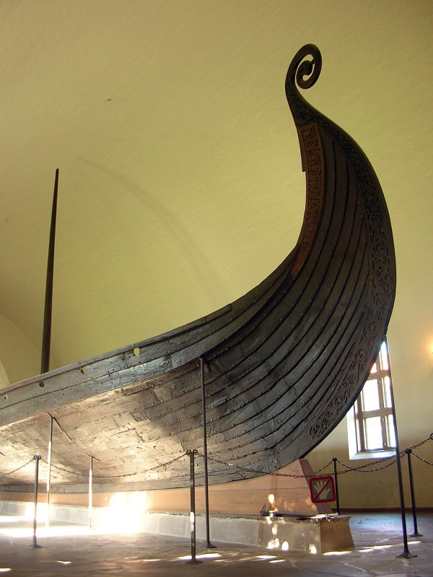
Norway
2007
6 weeks
12 architects
20,000,000 LOC
1 big mess
5 minute chat
4 years
0 seconds downtime
Life changed

Slide 6
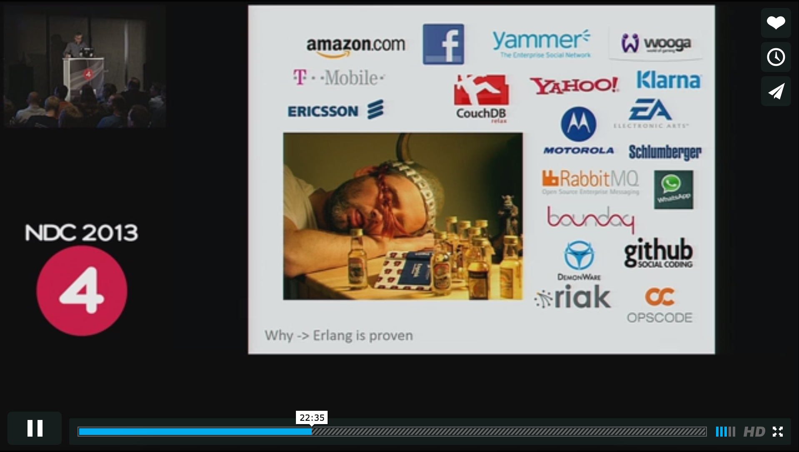
Google “NDC Erlang jumpstart”
Norway
2007
6 weeks
12 architects
20,000,000 LOC
1 big mess
5 minute chat
4 years
0 seconds downtime
Life changed
https://vimeo.com/68327403#t=22m35s

Slide 7
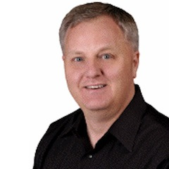
Hi.

Slide 8
Hey! You’re…. that guy!

Slide 9
Um… yes, that Dave Thomas guy.

Slide 10
Ah! You’re one of the original signatories of the Agile Manifesto, right?

Slide 11
Yep

Slide 12
Dude! You’re the guy who popularized Ruby

Slide 13
Boo-ya!

Slide 14
They call you the “king maker”
of Ruby

Slide 15
Agile and Ruby have had a huge influence on all devs.

Slide 16
Wait… what are you doing in Bryan’s talk?

Slide 17

Notes:
~”I came across Ruby in 1998, I downloaded it, compiled it, and fell in love…
Fast forward 15 years… I was bemoaning the fact that I wanted to find a way
to show people functional programming concepts without the kind of academic trappings
those books seem to attract. Corey Haines told me to look at Elixir.
I did, and I felt the same way I felt when I first saw Ruby.”
Dave Thomas. Programming Elixir, B15.0 (Kindle Locations 388-389). The Pragmatic Bookshelf, LLC.

Slide 18



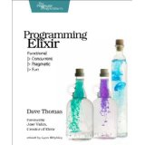
“Programmers not on board with functional programming in 5 years will be maintenance programmers.”
- Dave Thomas @pragdave GOTO Chicago 2014

Slide 19
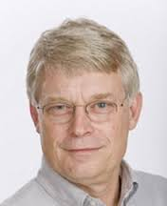
“The ‘When’ is pretty much now.”
-Robert Martin “Functional Programming What? Why? When?” NDC London 2013

Slide 20
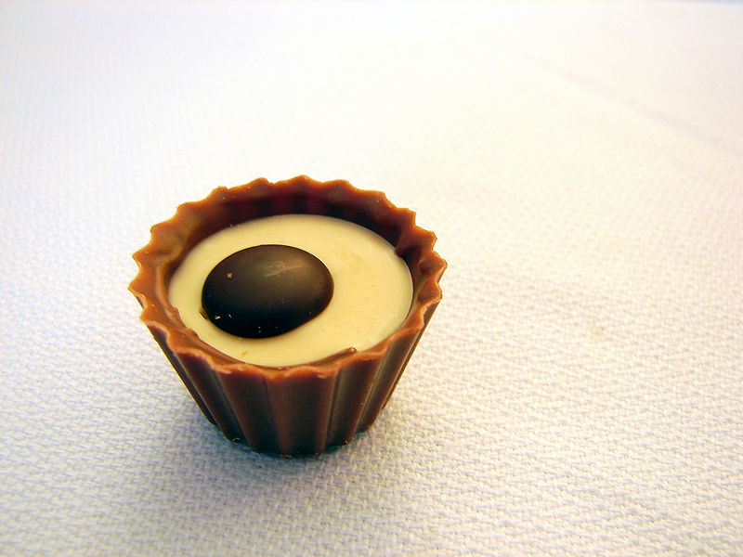
What is your language’s sweet spot?
Doing Awesome-Thing-X
… on a single thread …
…within a single OS process…
…on a single computer
Notes:
http://commons.wikimedia.org/wiki/File:Chocolate_candy_piece.jpg

Slide 21
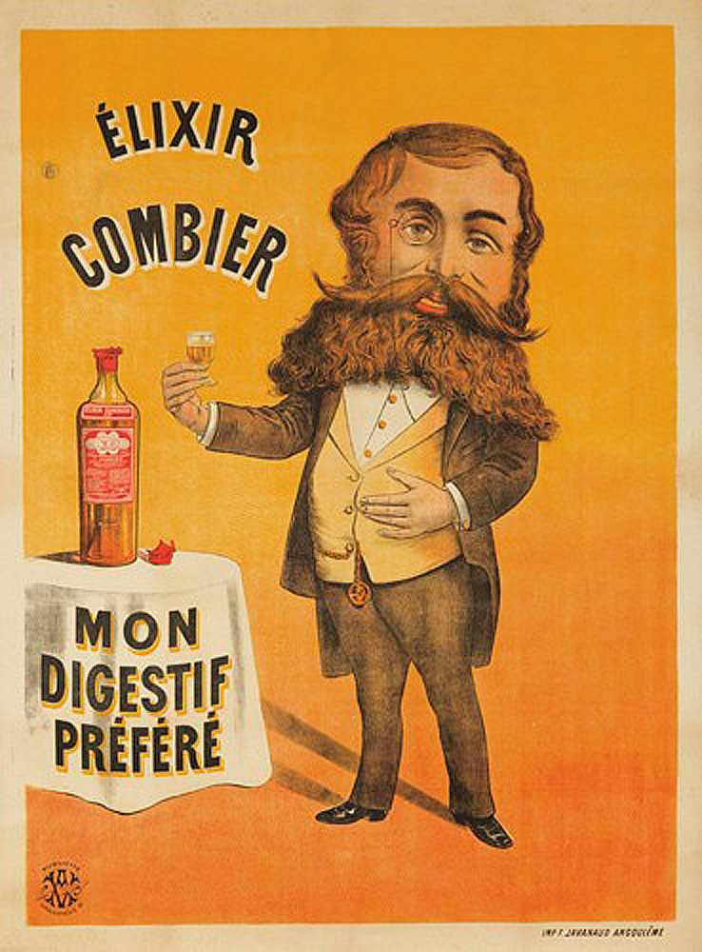

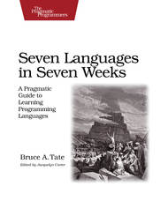
History of Elixir
Notes:
WikiMedia commons
http://commons.wikimedia.org/wiki/File:%C3%89lixir_Combier.jpg

Slide 22

History of Elixir
Notes:
WikiMedia commons
http://commons.wikimedia.org/wiki/File:%C3%89lixir_Combier.jpg

Slide 23
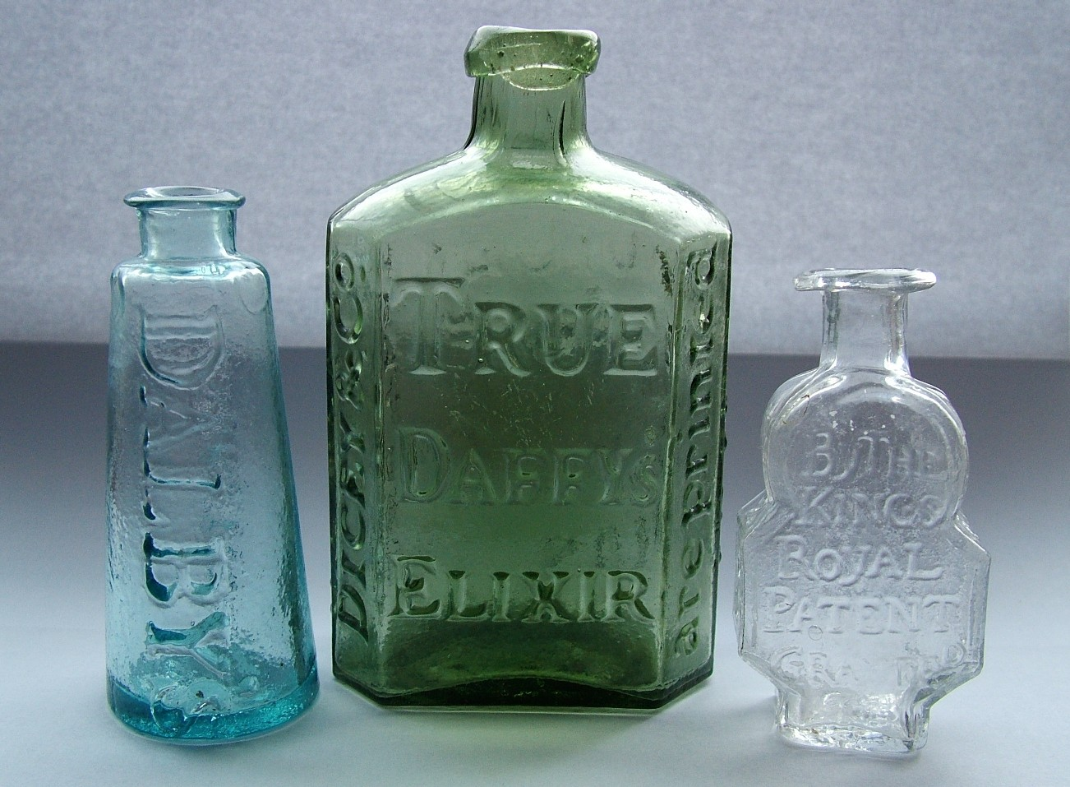
tincture of + Erlang + Ruby + Clojure + F# Language Invigorating
Erlang VM
O T P
Notes:
WikiMedia commons
http://commons.wikimedia.org/wiki/File:Three_early_medicine_bottles.jpg

Slide 24
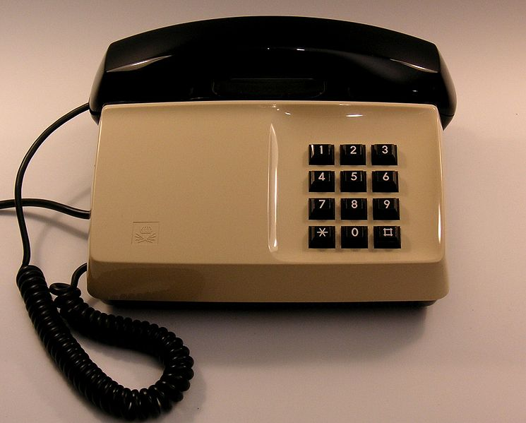
Fault-tolerant Concurrent Distributed
Notes:
WikiMedia commons
Swedish standard phone "Diavox" 1976, Ericsson Diavox telephone, made for Televerket (national telecom), Sweden.
"Diavox 1975 beige" by Holger.Ellgaard - Own work. Licensed under Creative Commons Attribution-Share Alike 3.0 via Wikimedia Commons - http://commons.wikimedia.org/wiki/File:Diavox_1975_beige.jpg#mediaviewer/File:Diavox_1975_beige.jpg

Slide 25
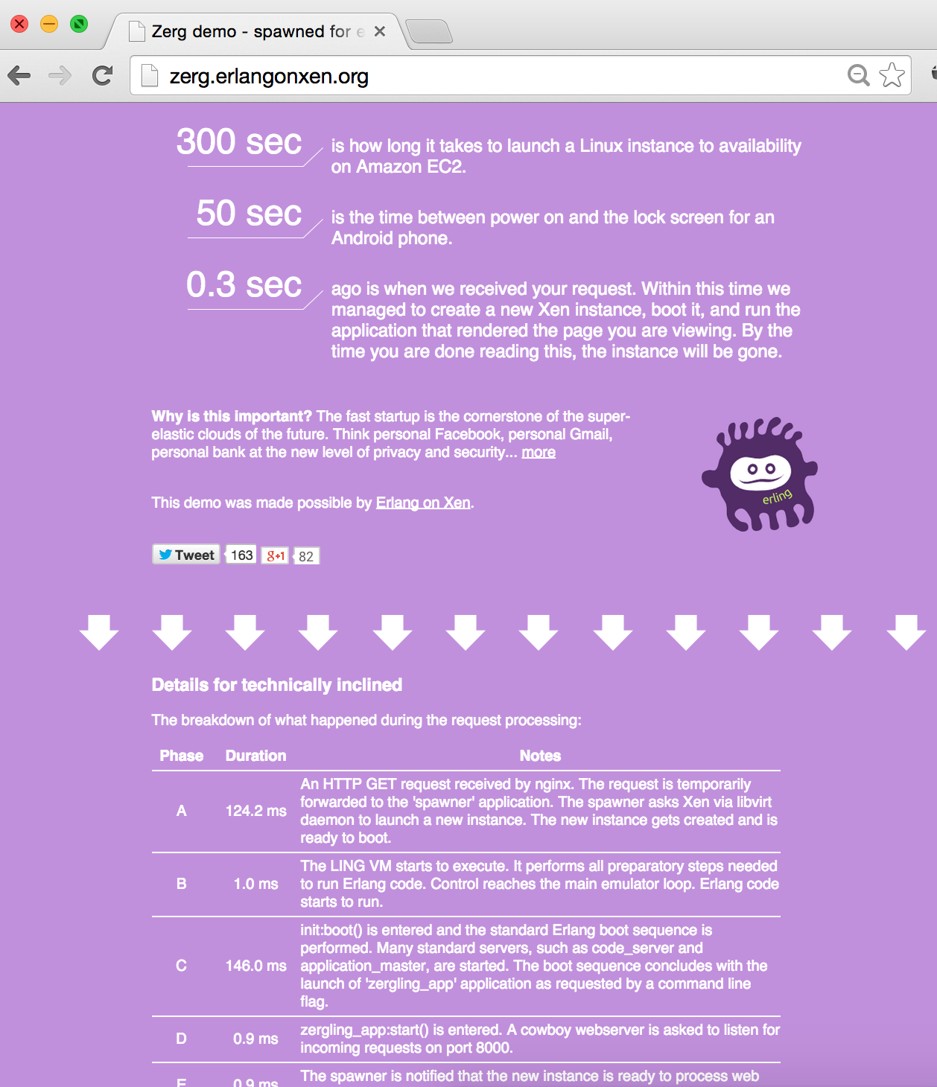
Elixir in Context
.NET dev stack
ErlangVM dev stack
C# / F#
Erlang / Elixir
.NET Framework
OTP
250+ years
CLR
ERTS
VM + Kernel
+ STDLIB
OS (Windows, Linux, Mac)
OS (Windows, Linux, Mac, None)

Slide 26
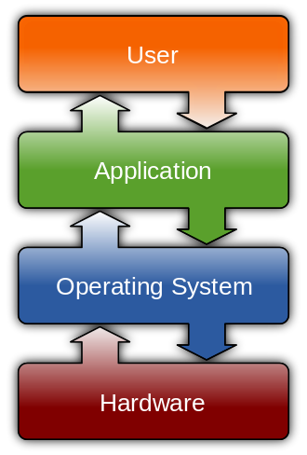
What does an OS do?
Process management
Interrupts
Memory management
File system
Device drivers
Networking
Security
I / O
http://en.wikipedia.org/wiki/Operating_system

Slide 27
What does an App (C/C#/Ruby/…) do?
Eat brains…
Brains!
Brains!!!
http://en.wikipedia.org/wiki/Operating_system

Slide 28



Slide 29
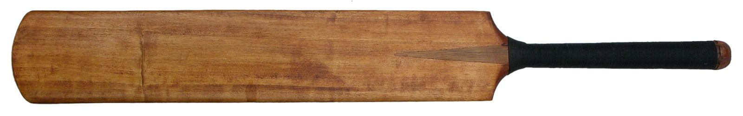
ErlangVM Processes
Notes:
WikiMedia commons
http://commons.wikimedia.org/wiki/File:Cricket_bat_01.jpg

Slide 30
One or .NET 4.0 (or Java 6) Thread (allocates one megabyte)
**********
**********
**********
**********
**********
**********
**********
**********
**********
**********
**********
**********
**********
**********
**********
**********
**********
**********
**********
**********
**********
**********
**********
**********
**********
**********
**********
**********
**********
**********
**********
**********
**********
**********
**********
**********
**********
**********
**********
**********
**********
**********
**********
**********
**********
**********
**********
**********
**********
**********
**********
**********
**********
**********
**********
**********
**********
**********
**********
**********
**********
**********
**********
**********
**********
**********
**********
**********
**********
**********
**********
**********
**********
**********
**********
**********
**********
**********
**********
**********
**********
**********
**********
**********
**********
**********
**********
**********
**********
**********
**********
**********
**********
**********
**********
**********
**********
**********
**********
**********
One ErlangVM Process (allocates one kilobyte)
*

Slide 31
Heap
Mailbox
Stack
Garbage Collector
Links and Monitors
*

Slide 32
Heap
Mailbox
Stack
*
Garbage Collector
Links and Monitors

Slide 33
Heap
Mailbox
Stack
*
Garbage Collector
Links and Monitors

Slide 34
Heap
Mailbox
Stack
*
Garbage Collector
Links and Monitors

Slide 35
Heap
Mailbox
Stack
*
Garbage Collector
Links and Monitors

Slide 36
ErlangVM Scheduling

Slide 37
*
*
*
CPU Core

Slide 38
Near-zero context switching cost
*
*
*
Reductions
- Do 2,000 operations
reduction1 reduction3 .
Reduction2000
- Move to the next guy - Repeat
CPU Core

Slide 39
Supervision and “let-it-crash”
worker
supervisor
*
*
CPU Core

Slide 40
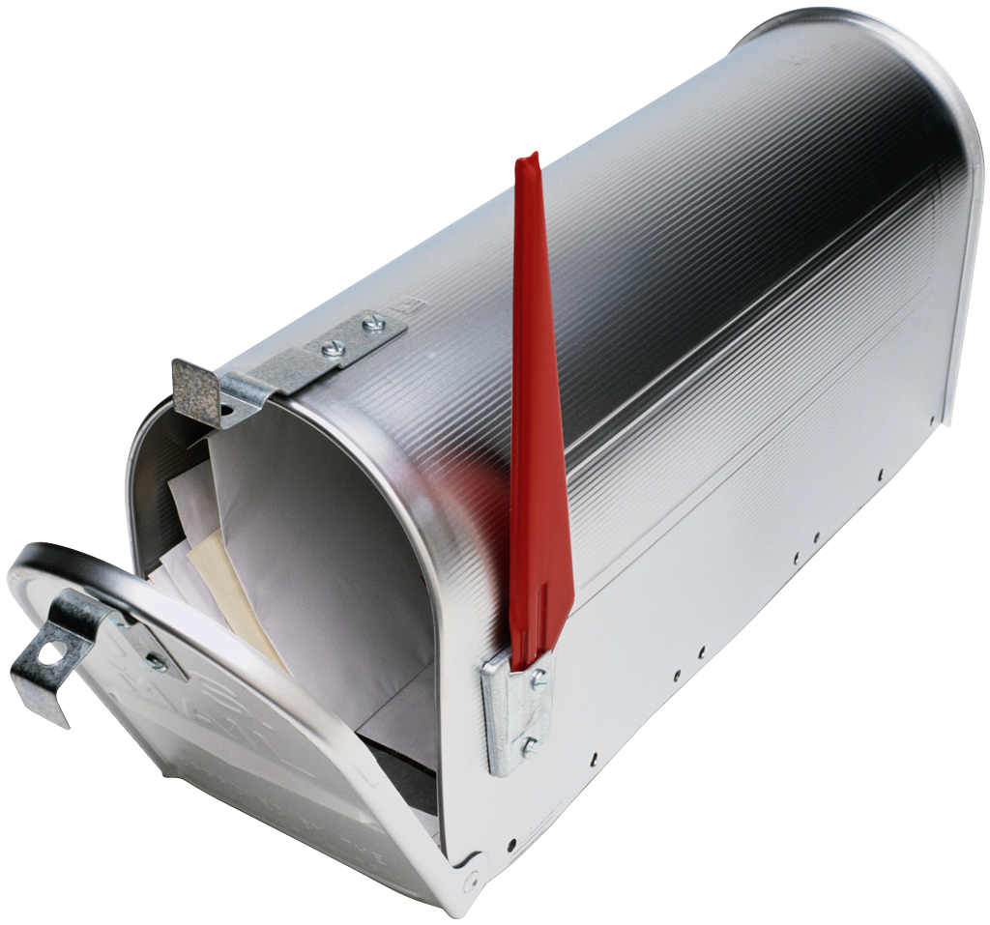
receive
*
*
*
CPU Core

Slide 41
receive
*
*
*
CPU Core

Slide 42
***** *****
***** *****
***** *****
***** *****
Core
Core
Core
Core

Slide 43
Scheduler migration : a game of balancing and compaction
***** *****
***** *****
***** *****
***** *****
Core
Core
Core
Core

Slide 44
Compaction for energy saving & memory locality
***** *****
***** *****
****
***
Core
Core
Core
Core

Slide 45
Compaction for energy saving & memory locality
Busy ☺
Busy ☺
work stealing!
***** *****
***** *****
****
***
Core
Core
Core
Core

Slide 46
Compaction for energy saving & memory locality
Busy ☺
Busy ☺
work stealing!
***** *****
***** *****
****
***
Core
Core
Core
Core

Slide 47
Compaction for energy saving & memory locality
Busy ☺
Busy ☺
work stealing!
***** *****
***** *****
****
***
Core
Core
Core
Core

Slide 48
Compaction for energy saving & memory locality
Busy ☺
Busy ☺
Busy ☺
Sleepy ☺
***** *****
***** *****
**** ***
Core
Core
Core
Core

Slide 49
***** *****
***** *****
***** *****
*
Core
Core
Core
Core

Slide 50
Scheduler migration : balance to prevent overburden
***** ***** *****
***** *****
***** *****
*
Core
Core
Core
Core

Slide 51

Scheduler migration : balance to prevent overburden
***** ***** ***** *****
***** *****
***** *****
*
Core
Core
Core
Core
Notes:
"DIN 4844-2 Warnung vor feuergefaehrlichen Stoffen D-W001" by Torsten Henning - drawn by author. Licensed under Public domain via Wikimedia Commons - http://commons.wikimedia.org/wiki/File:DIN_4844-2_Warnung_vor_feuergefaehrlichen_Stoffen_D-W001.svg#mediaviewer/File:DIN_4844-2_Warnung_vor_feuergefaehrlichen_Stoffen_D-W001.svg

Slide 52
Scheduler migration : balance to prevent overburden
work stealing!
***** ***** ***** *****
***** *****
***** *****
*
Core
Core
Core
Core
Notes:
"DIN 4844-2 Warnung vor feuergefaehrlichen Stoffen D-W001" by Torsten Henning - drawn by author. Licensed under Public domain via Wikimedia Commons - http://commons.wikimedia.org/wiki/File:DIN_4844-2_Warnung_vor_feuergefaehrlichen_Stoffen_D-W001.svg#mediaviewer/File:DIN_4844-2_Warnung_vor_feuergefaehrlichen_Stoffen_D-W001.svg

Slide 53
Scheduler migration : balance to prevent overburden
work stealing!
***** *****
***** *****
***** *****
***** *****
Core
Core
Core
Core

Slide 54
massive concurrency preemptive multitasking
soft real-time low latency over raw throughput
***** *****
***** *****
***** *****
***** *****
Core
Core
Core
Core

Slide 55





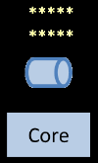
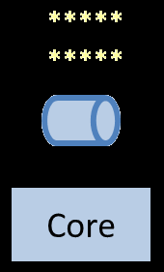
Notes:
WikiMedia commons
http://commons.wikimedia.org/wiki/File:Long_Water_birds.JPG

Slide 56
Node.ping :node10
Node.ping :node9
Node.ping :node8
Node.ping :node7
Node.ping :node6
Node.ping :node5
Node.ping :node4
Node.ping :node3
Node.ping :node2
Notes:
WikiMedia commons
http://commons.wikimedia.org/wiki/File:Long_Water_birds.JPG

Slide 57
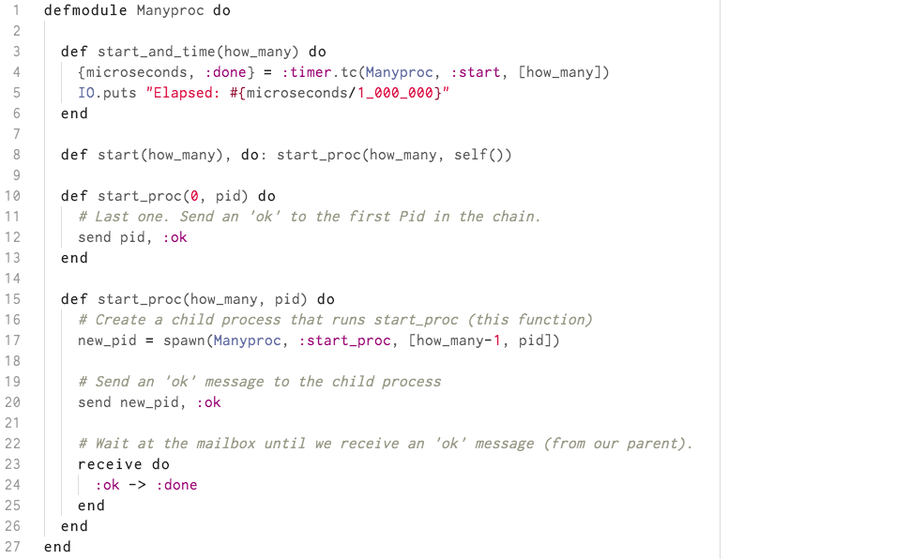
Time for a Demo?

Slide 58
“The performance
of a concurrent language
is predicated by three things:
the context switching time,
The message passing time,
and the time to create a process.”
–Mike Williams

Slide 59
‘86
‘06
≠
Concurrency
Parallelism
structure
execution
lots of things at once

Slide 60
Princeton University 1930s
Languages
Imperative
Procedural
OO
Declarative
Functional
Data flow
Logic

Slide 61

ErlangVM as the mobile backend
64 billion messages per day (~741,000 per second)
600 million active users
8,000 cores
Hundreds of nodes
10 Erlang engineers
60 million users per Erlang engineer
19 billion reasons to learn about the Erlang VM

Slide 62
tincture of + Erlang + Ruby + Clojure + F# Language Invigorating
Erlang VM
O T P
Notes:
WikiMedia commons
http://commons.wikimedia.org/wiki/File:Three_early_medicine_bottles.jpg

Slide 63
Interactive Elixir (IEX)
$

Slide 64
Interactive Elixir (IEX)
$ iex

Slide 65
Interactive Elixir (IEX)
$ iex
Erlang/OTP 17 [erts-6.1]
Interactive Elixir (0.15.1)
iex(1)>

Slide 66
Mix
mix # Runs project
mix compile # Compile source
mix deps # Dependencies
mix new # Creates new project
mix test # Runs project tests
(a ton more)

Slide 67
Types
iex> 1 # integer
iex> 0x1F # integer
iex> 1.0 # float
iex> :atom # atom
iex> "elixir" # string
iex> [1, 2, 3] # list
iex> {1, 2, 3} # tuple
iex> %{name: “Bryan”} # map

Slide 68
Pattern Matching
iex(1)>

Slide 69
Pattern Matching
iex(1)> list = [1,2,3]

Slide 70
Pattern Matching
iex(1)> list = [1,2,3]
[1, 2, 3]
iex(2)>

Slide 71
Pattern Matching
iex(1)> list = [1,2,3]
[1, 2, 3]
iex(2)> case list do

Slide 72
Pattern Matching
iex(1)> list = [1,2,3]
[1, 2, 3]
iex(2)> case list do
...(2)>

Slide 73
Pattern Matching
iex(1)> list = [1,2,3]
[1, 2, 3]
iex(2)> case list do
...(2)> [11,12,13] -> "won't match”

Slide 74
Pattern Matching
iex(1)> list = [1,2,3]
[1, 2, 3]
iex(2)> case list do
...(2)> [11,12,13] -> "won't match"
...(2)>

Slide 75
Pattern Matching
iex(1)> list = [1,2,3]
[1, 2, 3]
iex(2)> case list do
...(2)> [11,12,13] -> "won't match"
...(2)> [1,x,3] -> "matches & binds #{x} to x”

Slide 76
Pattern Matching
iex(1)> list = [1,2,3]
[1, 2, 3]
iex(2)> case list do
...(2)> [11,12,13] -> "won't match"
...(2)> [1,x,3] -> "matches & binds #{x} to x"
...(2)>

Slide 77
Pattern Matching
iex(1)> list = [1,2,3]
[1, 2, 3]
iex(2)> case list do
...(2)> [11,12,13] -> "won't match"
...(2)> [1,x,3] -> "matches & binds #{x} to x"
...(2)> _ -> "default”

Slide 78
Pattern Matching
iex(1)> list = [1,2,3]
[1, 2, 3]
iex(2)> case list do
...(2)> [11,12,13] -> "won't match"
...(2)> [1,x,3] -> "matches & binds #{x} to x"
...(2)> _ -> "default"
...(2)>

Slide 79
Pattern Matching
iex(1)> list = [1,2,3]
[1, 2, 3]
iex(2)> case list do
...(2)> [11,12,13] -> "won't match"
...(2)> [1,x,3] -> "matches & binds #{x} to x"
...(2)> _ -> "default"
...(2)> end

Slide 80
Pattern Matching
iex(1)> list = [1,2,3]
[1, 2, 3]
iex(2)> case list do
...(2)> [11,12,13] -> "won't match"
...(2)> [1,x,3] -> "matches & binds #{x} to x"
...(2)> _ -> "default"
...(2)> end
"matches & binds 2 to x”
iex(3)>

Slide 81
if (and UTF-8)
if lang == :japanese do
IO.puts “ハローワールド”
else
IO.puts “Hello World”
end

Slide 82
if (without an else)
if 2+2 == 3 do
IO.puts “Uh oh! 1984”
end

Slide 83
Digit Separators
iex(1)>

Slide 84
Digit Separators
iex(1)> 100000

Slide 85
Digit Separators
iex(1)> 100000
100000
iex(2)>

Slide 86
Digit Separators
iex(1)> 100000
100000
iex(2)> 100_000

Slide 87

Digit Separators
iex(1)> 100000
100000
iex(2)> 100_000
100000
iex(3)>

Slide 88
Digit Separators
iex(1)> 100000
100000
iex(2)> 100_000
100000
iex(3)> 100_000 + 5_000

Slide 89
Digit Separators
iex(1)> 100000
100000
iex(2)> 100_000
100000
iex(3)> 100_000 + 5_000
105000
iex(4)>

Slide 90
Maps
iex(1)>

Slide 91
Maps
iex(1)> person = %{name: "Bryan", beardy: true}

Slide 92
Maps
iex(1)> person = %{name: "Bryan", beardy: true}
%{beardy: true, name: "Bryan"}
iex(2)>

Slide 93
Maps
iex(1)> person = %{name: "Bryan", beardy: true}
%{beardy: true, name: "Bryan"}
iex(2)> person[:name]

Slide 94
Maps
iex(1)> person = %{name: "Bryan", beardy: true}
%{beardy: true, name: "Bryan"}
iex(2)> person[:name]
"Bryan"
iex(3)>

Slide 95
Maps
iex(1)> person = %{name: "Bryan", beardy: true}
%{beardy: true, name: "Bryan"}
iex(2)> person[:name]
"Bryan"
iex(3)> person.name

Slide 96
Maps
iex(1)> person = %{name: "Bryan", beardy: true}
%{beardy: true, name: "Bryan"}
iex(2)> person[:name]
"Bryan"
iex(3)> person.name
"Bryan"
iex(4)>

Slide 97
Maps
iex(1)> person = %{name: "Bryan", beardy: true}
%{beardy: true, name: "Bryan"}
iex(2)> person[:name]
"Bryan"
iex(3)> person.name
"Bryan"
iex(4)> %{person | name: "Bryan Hunter”}

Slide 98
Maps
iex(1)> person = %{name: "Bryan", beardy: true}
%{beardy: true, name: "Bryan"}
iex(2)> person[:name]
"Bryan"
iex(3)> person.name
"Bryan"
iex(4)> %{person | name: "Bryan Hunter"}
%{beardy: true, name: "Bryan Hunter"}
iex(5)>

Slide 99
Structs
iex(1)>

Slide 100
Structs
iex(1)> defmodule Person do

Slide 101
Structs
iex(1)> defmodule Person do
...(1)>

Slide 102
Structs
iex(1)> defmodule Person do
...(1)> defstruct name: "", sleepy: false

Slide 103
Structs
iex(1)> defmodule Person do
...(1)> defstruct name: "", sleepy: false
...(1)>

Slide 104
Structs
iex(1)> defmodule Person do
...(1)> defstruct name: "", sleepy: false
...(1)> end

Slide 105
Structs
iex(1)> defmodule Person do
...(1)> defstruct name: "", sleepy: false
...(1)> end
{:module, Person, [name: "", sleepy: false]}
iex(2)>

Slide 106
Structs
iex(1)> defmodule Person do
...(1)> defstruct name: "", sleepy: false
...(1)> end
{:module, Person, [name: "", sleepy: false]}
iex(2)> %Person{}

Slide 107
Structs
iex(1)> defmodule Person do
...(1)> defstruct name: "", sleepy: false
...(1)> end
{:module, Person, [name: "", sleepy: false]}
iex(2)> %Person{}
%Person{name: "", sleepy: false}
iex(3)>

Slide 108
Structs
iex(1)> defmodule Person do
...(1)> defstruct name: "", sleepy: false
...(1)> end
{:module, Person, [name: "", sleepy: false]}
iex(2)> %Person{}
%Person{name: "", sleepy: false}
iex(3)> bryan = %Person{name: "Bryan",sleepy: true}

Slide 109
Structs
iex(1)> defmodule Person do
...(1)> defstruct name: "", sleepy: false
...(1)> end
{:module, Person, [name: "", sleepy: false]}
iex(2)> %Person{}
%Person{name: "", sleepy: false}
iex(3)> bryan = %Person{name: "Bryan",sleepy: true}
%Person{name: "Bryan", sleepy: true}
iex(4)>

Slide 110
Structs
iex(1)> defmodule Person do
...(1)> defstruct name: "", sleepy: false
...(1)> end
{:module, Person, [name: "", sleepy: false]}
iex(2)> %Person{}
%Person{name: "", sleepy: false}
iex(3)> bryan = %Person{name: "Bryan",sleepy: true}
%Person{name: "Bryan", sleepy: true}
iex(4)> %Person{name: "Bryan", city: "Nashville”}

Slide 111
Structs
iex(1)> defmodule Person do
...(1)> defstruct name: "", sleepy: false
...(1)> end
{:module, Person, [name: "", sleepy: false]}
iex(2)> %Person{}
%Person{name: "", sleepy: false}
iex(3)> bryan = %Person{name: "Bryan",sleepy: true}
%Person{name: "Bryan", sleepy: true}
iex(4)> %Person{name: "Bryan", city: "Nashville"}
** (CompileError) iex:4: unknown key :city for struct Person
iex(5)>

Slide 112
Enumerables & Streams
iex(1)>

Slide 113
Enumerables & Streams
iex(1)> odd? = &(rem(&1, 2) != 0)

Slide 114
Enumerables & Streams
iex(1)> odd? = &(rem(&1, 2) != 0)
#Function<6.90072148/1 in :erl_eval.expr/5>
iex(2)>

Slide 115
Enumerables & Streams
iex(1)> odd? = &(rem(&1, 2) != 0)
#Function<6.90072148/1 in :erl_eval.expr/5>
iex(2)> 1..100_000 |>

Slide 116
Enumerables & Streams
iex(1)> odd? = &(rem(&1, 2) != 0)
#Function<6.90072148/1 in :erl_eval.expr/5>
iex(2)> 1..100_000 |>
...(2)>

Slide 117
Enumerables & Streams
iex(1)> odd? = &(rem(&1, 2) != 0)
#Function<6.90072148/1 in :erl_eval.expr/5>
iex(2)> 1..100_000 |>
...(2)> Enum.map(&(&1 * 3)) |>

Slide 118
Enumerables & Streams
iex(1)> odd? = &(rem(&1, 2) != 0)
#Function<6.90072148/1 in :erl_eval.expr/5>
iex(2)> 1..100_000 |>
...(2)> Enum.map(&(&1 * 3)) |>
...(2)> Enum.filter(odd?) |>

Slide 119
Enumerables & Streams
iex(1)> odd? = &(rem(&1, 2) != 0)
#Function<6.90072148/1 in :erl_eval.expr/5>
iex(2)> 1..100_000 |>
...(2)> Enum.map(&(&1 * 3)) |>
...(2)> Enum.filter(odd?) |>
...(2)>

Slide 120
Enumerables & Streams
iex(1)> odd? = &(rem(&1, 2) != 0)
#Function<6.90072148/1 in :erl_eval.expr/5>
iex(2)> 1..100_000 |>
...(2)> Enum.map(&(&1 * 3)) |>
...(2)> Enum.filter(odd?) |>
...(2)> Enum.sum

Slide 121
Enumerables & Streams
iex(1)> odd? = &(rem(&1, 2) != 0)
#Function<6.90072148/1 in :erl_eval.expr/5>
iex(2)> 1..100_000 |>
...(2)> Enum.map(&(&1 * 3)) |>
...(2)> Enum.filter(odd?) |>
...(2)> Enum.sum
7500000000
iex(3)>

Slide 122
Enumerables & Streams
iex(1)> odd? = &(rem(&1, 2) != 0)
#Function<6.90072148/1 in :erl_eval.expr/5>
iex(2)> 1..100_000 |>
...(2)> Enum.map(&(&1 * 3)) |>
...(2)> Enum.filter(odd?) |>
...(2)> Enum.sum
7500000000
iex(3)> 1..100_000 |>

Slide 123
Enumerables & Streams
iex(1)> odd? = &(rem(&1, 2) != 0)
#Function<6.90072148/1 in :erl_eval.expr/5>
iex(2)> 1..100_000 |>
...(2)> Enum.map(&(&1 * 3)) |>
...(2)> Enum.filter(odd?) |>
...(2)> Enum.sum
7500000000
iex(3)> 1..100_000 |>
...(3)>

Slide 124
Enumerables & Streams
iex(1)> odd? = &(rem(&1, 2) != 0)
#Function<6.90072148/1 in :erl_eval.expr/5>
iex(2)> 1..100_000 |>
...(2)> Enum.map(&(&1 * 3)) |>
...(2)> Enum.filter(odd?) |>
...(2)> Enum.sum
7500000000
iex(3)> 1..100_000 |>
...(3)> Stream.map(&(&1 * 3)) |>

Slide 125
Enumerables & Streams
iex(1)> odd? = &(rem(&1, 2) != 0)
#Function<6.90072148/1 in :erl_eval.expr/5>
iex(2)> 1..100_000 |>
...(2)> Enum.map(&(&1 * 3)) |>
...(2)> Enum.filter(odd?) |>
...(2)> Enum.sum
7500000000
iex(3)> 1..100_000 |>
...(3)> Stream.map(&(&1 * 3)) |>
...(3)>

Slide 126
Enumerables & Streams
iex(1)> odd? = &(rem(&1, 2) != 0)
#Function<6.90072148/1 in :erl_eval.expr/5>
iex(2)> 1..100_000 |>
...(2)> Enum.map(&(&1 * 3)) |>
...(2)> Enum.filter(odd?) |>
...(2)> Enum.sum
7500000000
iex(3)> 1..100_000 |>
...(3)> Stream.map(&(&1 * 3)) |>
...(3)> Stream.filter(odd?) |>

Slide 127
Enumerables & Streams
iex(1)> odd? = &(rem(&1, 2) != 0)
#Function<6.90072148/1 in :erl_eval.expr/5>
iex(2)> 1..100_000 |>
...(2)> Enum.map(&(&1 * 3)) |>
...(2)> Enum.filter(odd?) |>
...(2)> Enum.sum
7500000000
iex(3)> 1..100_000 |>
...(3)> Stream.map(&(&1 * 3)) |>
...(3)> Stream.filter(odd?) |>
...(3)>

Slide 128
Enumerables & Streams
iex(1)> odd? = &(rem(&1, 2) != 0)
#Function<6.90072148/1 in :erl_eval.expr/5>
iex(2)> 1..100_000 |>
...(2)> Enum.map(&(&1 * 3)) |>
...(2)> Enum.filter(odd?) |>
...(2)> Enum.sum
7500000000
iex(3)> 1..100_000 |>
...(3)> Stream.map(&(&1 * 3)) |>
...(3)> Stream.filter(odd?) |>
...(3)> Enum.sum

Slide 129
Enumerables & Streams
iex(1)> odd? = &(rem(&1, 2) != 0)
#Function<6.90072148/1 in :erl_eval.expr/5>
iex(2)> 1..100_000 |>
...(2)> Enum.map(&(&1 * 3)) |>
...(2)> Enum.filter(odd?) |>
...(2)> Enum.sum
7500000000
iex(3)> 1..100_000 |>
...(3)> Stream.map(&(&1 * 3)) |>
...(3)> Stream.filter(odd?) |>
...(3)> Enum.sum
7500000000
iex(4)>
Both implement
the Enumerable protocol

Slide 130
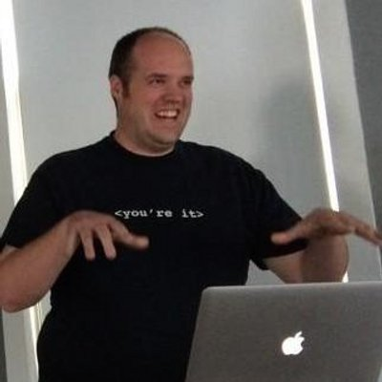
Enumerables & Streams
iex(1)> odd? = &(rem(&1, 2) != 0)
#Function<6.90072148/1 in :erl_eval.expr/5>
iex(2)> 1..100_000 |>
...(2)> Enum.map(&(&1 * 3)) |>
...(2)> Enum.filter(odd?) |>
...(2)> Enum.sum
7500000000
iex(3)> 1..100_000 |>
...(3)> Stream.map(&(&1 * 3)) |>
...(3)> Stream.filter(odd?) |>
...(3)> Enum.sum
7500000000
iex(4)>

Slide 131
tincture of + Erlang + Ruby + Clojure + F# Language Invigorating
Erlang VM
O T P
Notes:
WikiMedia commons
http://commons.wikimedia.org/wiki/File:Three_early_medicine_bottles.jpg

Slide 132
Behaviours
Application
Supervisor
GenServer
GenEvent

Slide 133
Application
Supervisor
Supervisor
GenServer
Supervisor
GenServer
GenServer
GenServer
GenServer
*
GenServer
GenServer
GenServer

Slide 134
Agents
iex>

Slide 135
Agents
iex> {:ok, agent} = Agent.start_link fn -> [] end

Slide 136
Agents
iex> {:ok, agent} = Agent.start_link fn -> [] end
{:ok, #PID<0.57.0>}
iex>

Slide 137
Agents
iex> {:ok, agent} = Agent.start_link fn -> [] end
{:ok, #PID<0.57.0>}
iex> Agent.update(agent, fn list->["eggs"|list] end)

Slide 138
Agents
iex> {:ok, agent} = Agent.start_link fn -> [] end
{:ok, #PID<0.57.0>}
iex> Agent.update(agent, fn list->["eggs"|list] end)
:ok
iex>

Slide 139
Agents
iex> {:ok, agent} = Agent.start_link fn -> [] end
{:ok, #PID<0.57.0>}
iex> Agent.update(agent, fn list->["eggs"|list] end)
:ok
iex> Agent.update(agent, fn list->["milk"|list] end)
Notes:
Agents are a simple abstraction around state.
Often in Elixir there is a need to share or store state that must be accessed from different processes or by the same process at different points in time.
The Agent module provides a basic server implementation that allows state to be retrieved and updated via a simple API.

Slide 140
Agents
iex> {:ok, agent} = Agent.start_link fn -> [] end
{:ok, #PID<0.57.0>}
iex> Agent.update(agent, fn list->["eggs"|list] end)
:ok
iex> Agent.update(agent, fn list->["milk"|list] end)
:ok
iex>
Notes:
Agents are a simple abstraction around state.
Often in Elixir there is a need to share or store state that must be accessed from different processes or by the same process at different points in time.
The Agent module provides a basic server implementation that allows state to be retrieved and updated via a simple API.

Slide 141
Agents
iex> {:ok, agent} = Agent.start_link fn -> [] end
{:ok, #PID<0.57.0>}
iex> Agent.update(agent, fn list->["eggs"|list] end)
:ok
iex> Agent.update(agent, fn list->["milk"|list] end)
:ok
iex> Agent.get(agent, fn list->list end)

Slide 142
Agents
iex> {:ok, agent} = Agent.start_link fn -> [] end
{:ok, #PID<0.57.0>}
iex> Agent.update(agent, fn list->["eggs"|list] end)
:ok
iex> Agent.update(agent, fn list->["milk"|list] end)
:ok
iex> Agent.get(agent, fn list->list end)
["milk", "eggs"]
iex>

Slide 143
Agents
iex> {:ok, agent} = Agent.start_link fn -> [] end
{:ok, #PID<0.57.0>}
iex> Agent.update(agent, fn list->["eggs"|list] end)
:ok
iex> Agent.update(agent, fn list->["milk"|list] end)
:ok
iex> Agent.get(agent, fn list->list end)
["milk", "eggs"]
iex> Agent.stop(agent)

Slide 144
Agents
iex> {:ok, agent} = Agent.start_link fn -> [] end
{:ok, #PID<0.57.0>}
iex> Agent.update(agent, fn list->["eggs"|list] end)
:ok
iex> Agent.update(agent, fn list->["milk"|list] end)
:ok
iex> Agent.get(agent, fn list->list end)
["milk", "eggs"]
iex> Agent.stop(agent)
:ok

Slide 145
Tasks
task = Task.async(fn -> do_some_work() end)
data = do_some_other_work()
# Next, await the response from do_some_work
other_data = Task.await(task)

Slide 146
Two Neat Extra Bits

Slide 147
Phoenix is to Elixir
as
Rails is to Ruby

Slide 148
Ecto is to Elixir
as
Active Record is to Ruby
as
LINQ is to .NET

Slide 149
Time for a demo?

Slide 150
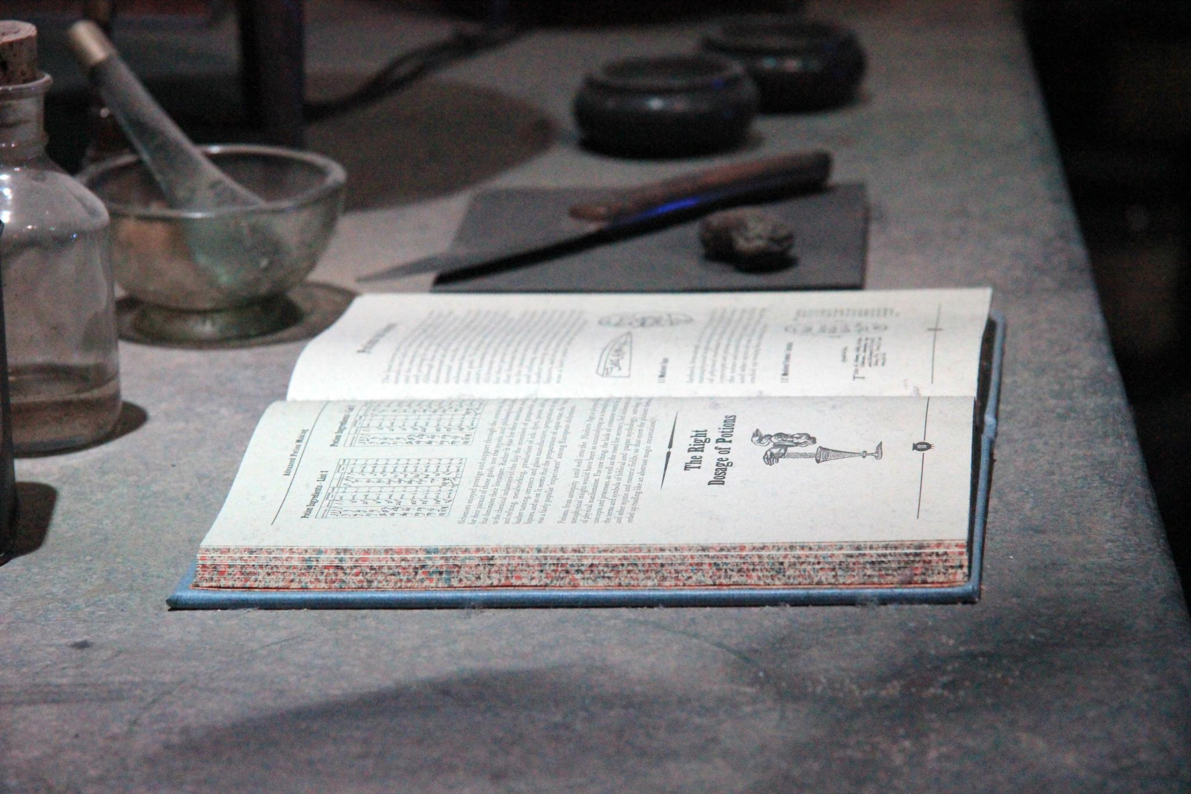
What We’ve Learned
Notes:
WikiMedia commons
http://commons.wikimedia.org/wiki/File:The_Making_of_Harry_Potter_29-05-2012_(7190379225).jpg

Slide 151
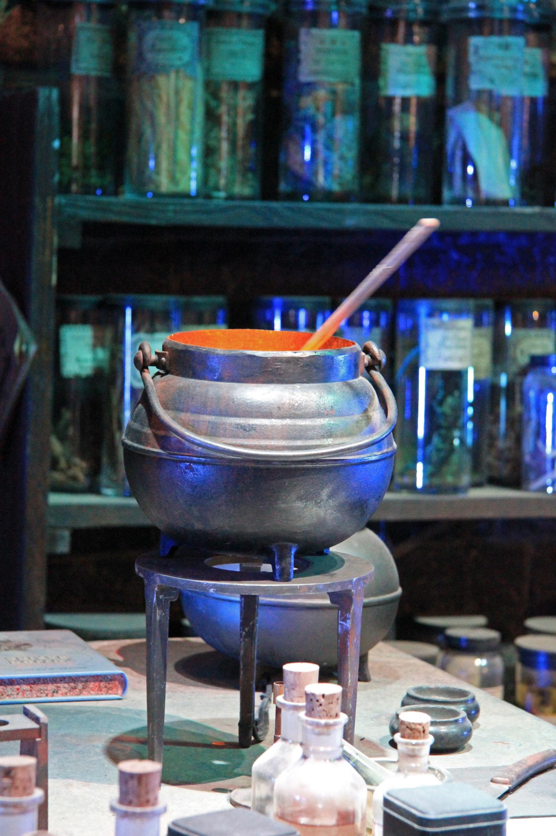
Everything available to Erlang is available to Elixir
Zero inter-op penalties
Notes:
WikiMedia commons
http://commons.wikimedia.org/wiki/File:The_Making_of_Harry_Potter_29-05-2012_(7190379821).jpg

Slide 152
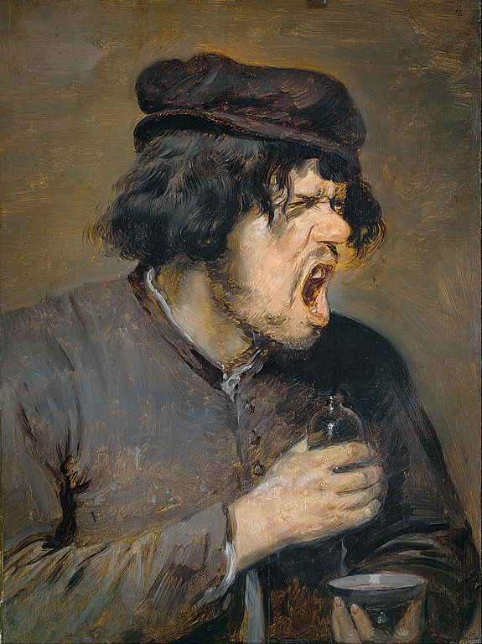
Erlang makes the hard things easy
and the easy things hard
Elixir makes the hard things easy
and the easy things easy too
Notes:
WikiMedia commons
http://commons.wikimedia.org/wiki/File:Adriaen_Brouwer_-_The_Bitter_Potion_-_Google_Art_Project.jpg

Slide 153
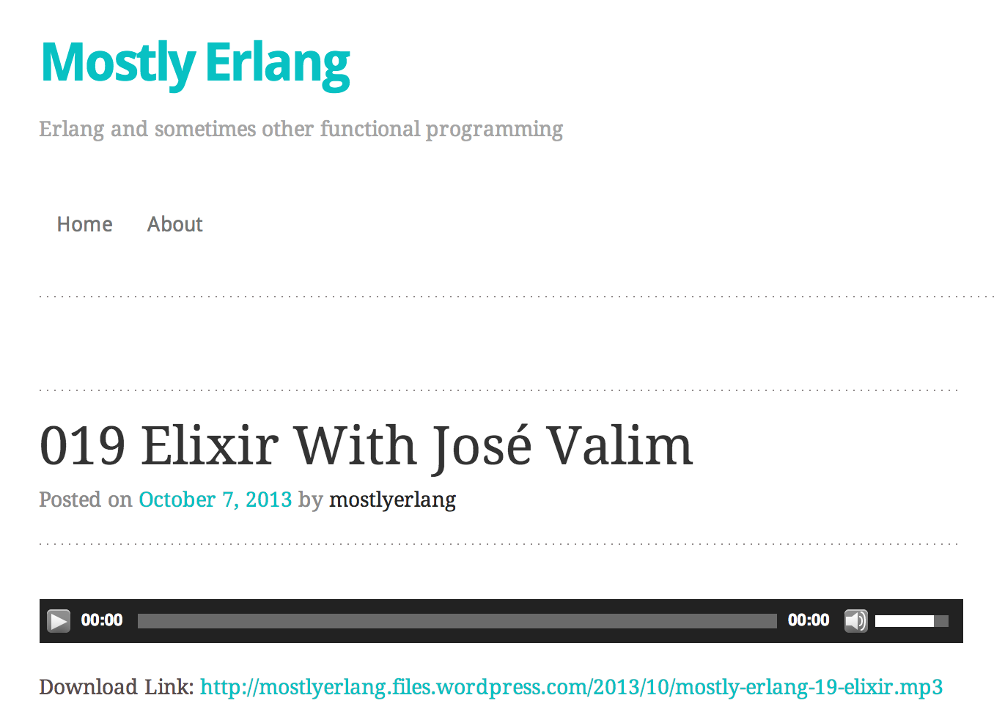
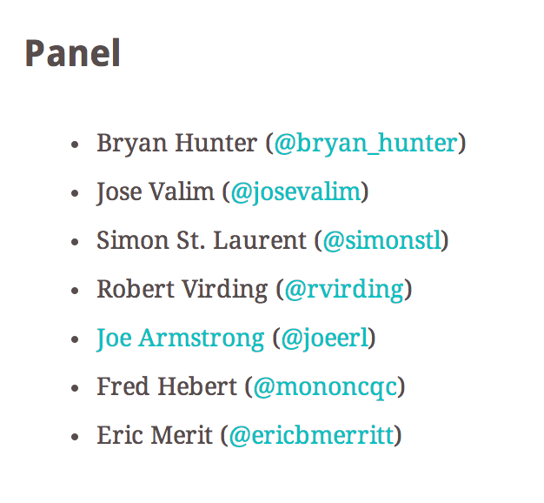

Slide 154
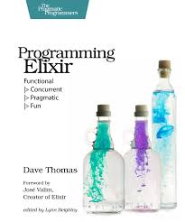

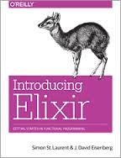

Books

Slide 155


Elixir Sips

Slide 156
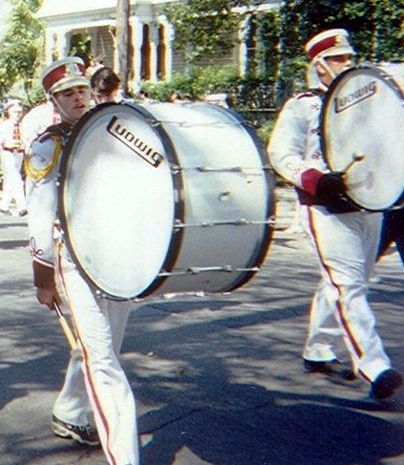


Join your local polyglot FP group
http://nashfp.org

Slide 157
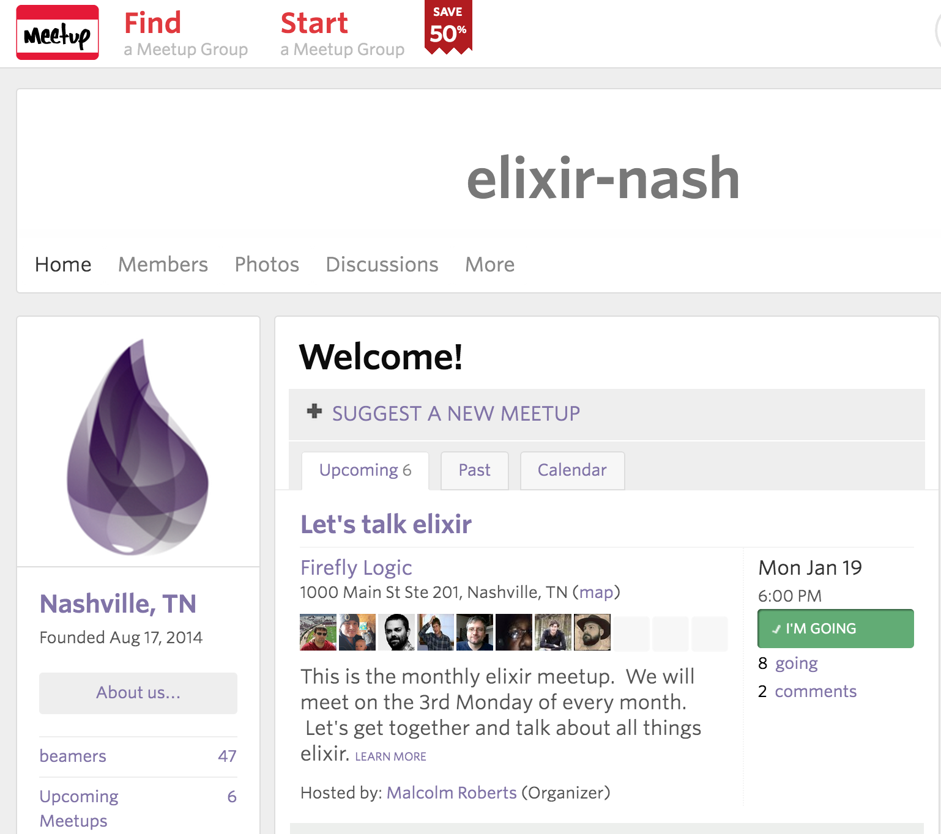

Slide 158
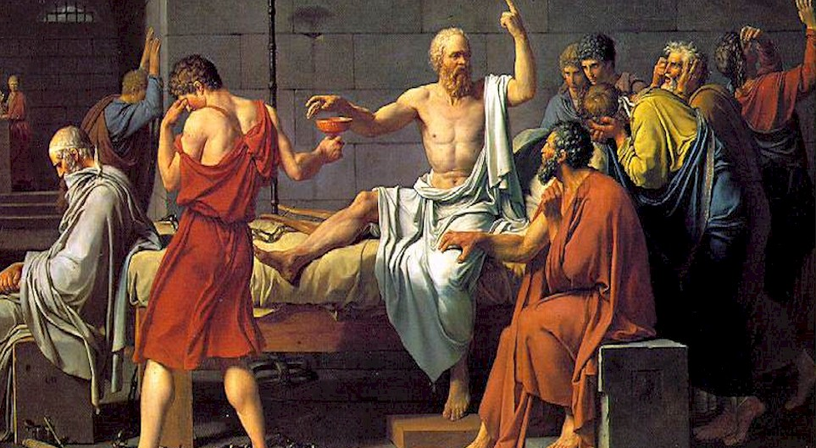
FP and Ethics
Notes:
WikiMedia commons
http://commons.wikimedia.org/wiki/File:David_-_The_Death_of_Socrates.jpg

Slide 159
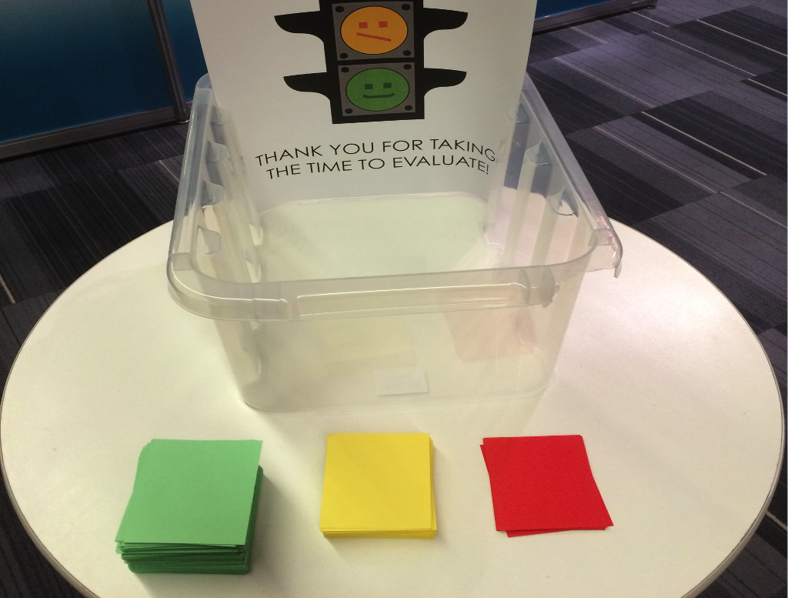

Questions? Feedback?
Bryan Hunter
Twitter: @bryan_hunter
Email: bryan.hunter@fireflylogic.com
Firefly Logic, Inc.
1000 Main Street #201 Nashville, TN 37206
http://fireflylogic.com contact@fireflylogic.com

